Slide 1
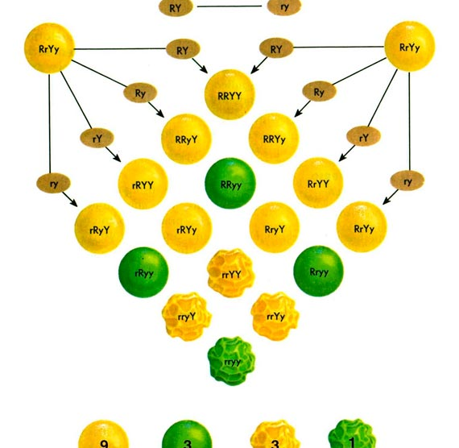
The Other M.R.
GERD, Asthma and, Study Designs
Brian Locke MD
PCCM Fellow, MSCI student, T32... person

Slide 2
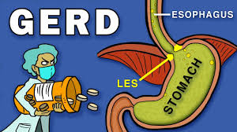
Case & Journal Club
65M with new onset asthma as proven by highly variable episodes of wheezing, reversible obstruction on PFTs with high DLCo, no notable CT findings, and both improvement with treatments (pred, ICS) and non-improvement with non-treatment.
Why did he get asthma?
Low Eos and IgE, but did acquire a cat
Some chronic rhinosinusitis
Owns a lawn spraying company
Mild OSA
Has heartburn that goes away with TUMS

Slide 3

GERD… 2 problems in practice
Wason's 2-4-6 task
The goal is to guess the pattern
You say any sequence of 3 numbers and I’ll say yes or no whether it fits the pattern.
“4-6-8” Yes, “10-12-14” Yes, “-3- -1- 1” Yes, “10-20-30” Yes, “2-5-8” Yes
“Positive Bias”: look for evidence supporting our theory
Falsification: reliable if it withstands attempts to disprove
Are there any clinical findings that tell us definitively that reflux isn’t the cause of asthma?
Empiric trials: harder to separate signal from noise the more variable an outcome is (Asthma is defined by variability)
Barnum Statements:
Basis of astrology, cold reading, etc. Statements that seem very personal but are generically applicable.
You have a great need for other people to like and admire you.
You have a tendency to be critical of yourself.
3. You sometimes have reflux after eating spicy food.
Notes:
40 to 90 percent of patients with symptoms suggestive of GERD have a symptomatic response to proton pump inhibitors (PPIs), a response to antisecretory therapy is not a diagnostic criterion for GERD. For pH monitoring pooled sensitivity and specificity were 78 and 54 percent, respectively.
[ ] is this the population attributable fraction problem?
[ ] clean up this slide a bit
[ ] Confirmation bias

Slide 4
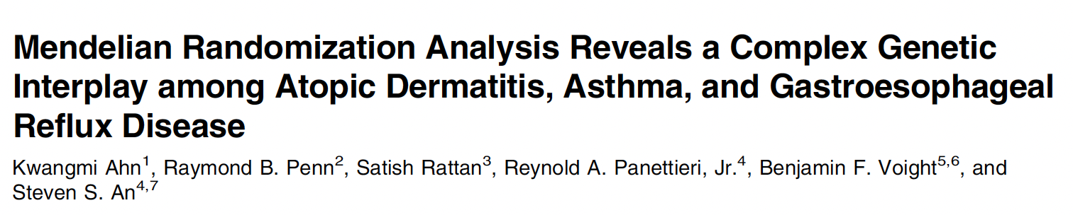
Roadmap to Journal Club
How do we know things:
RCTs
Observational Research
Instrumental Variable Analysis
Mendelian Randomization
Study Ahn et al (AJRCCM 2023)

Slide 5
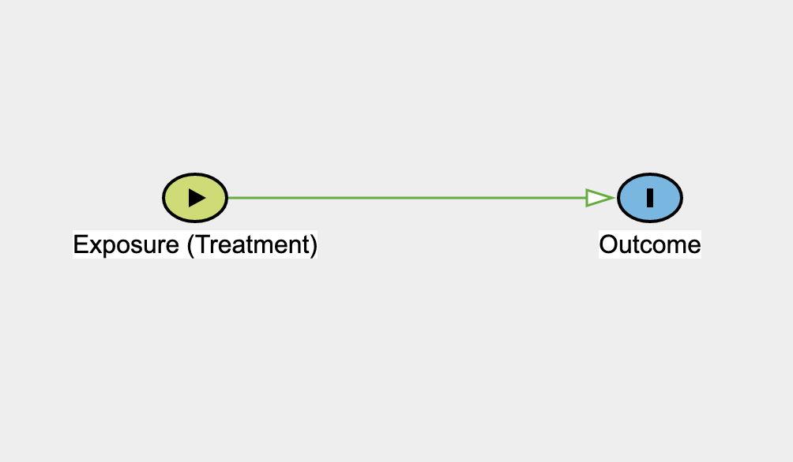
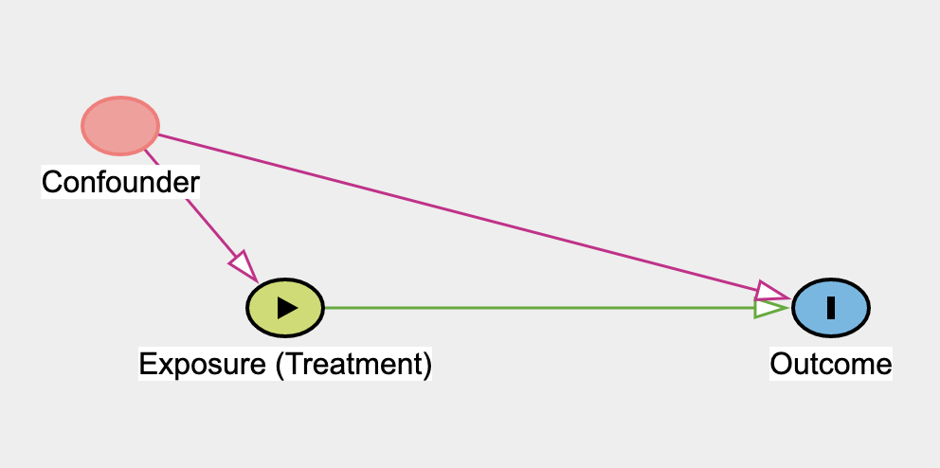
Causal Diagrams
Terminology: we are interested of the effect of an exposure (E) on an outcome (O)
Causal diagram: Directed Acyclic Graph
“Associated with…”: ‘weasel word’
“Coffee intake is associated with longevity. You should drink more coffee”
Notes:
DAGis a graphical representation of the potential causal
relationships between variables, with arrows used to denote the direction
of causality.
[ ] another potentially useful reference?
https://www.atsjournals.org/doi/epdf/10.1513/AnnalsATS.202110-1188PS?role=tab

Slide 6

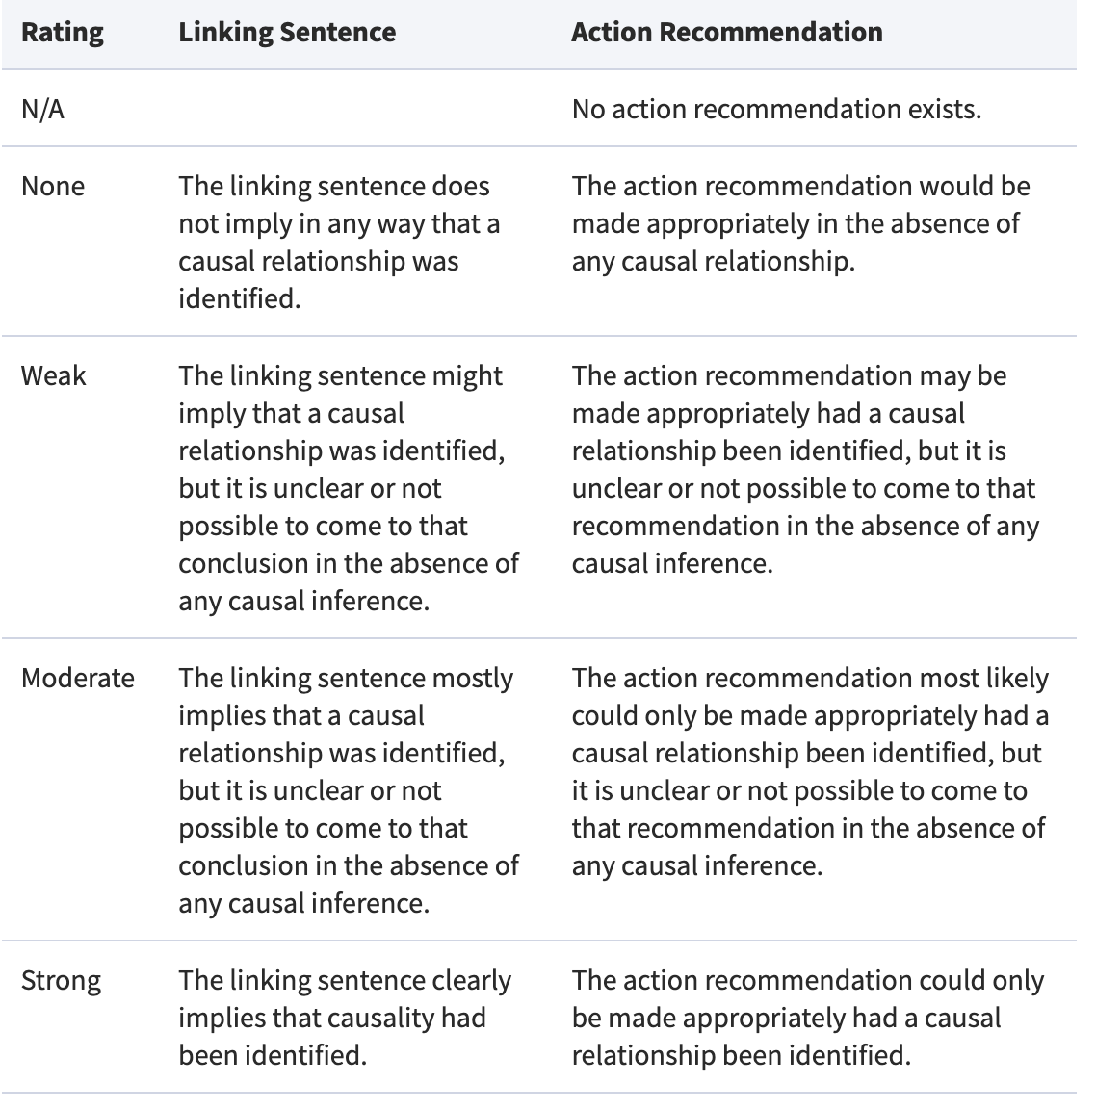
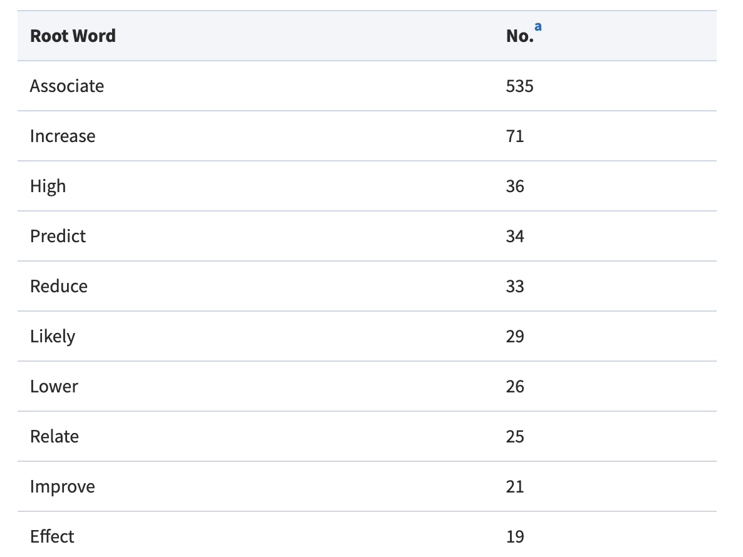
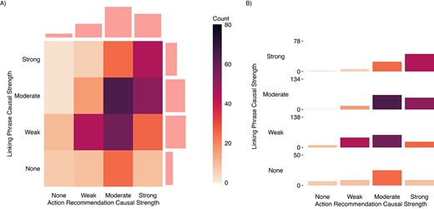
by far the most common word used linking exposures and outcomes was “associate”;
although few studies explicitly declared an interest in estimating causal effects, the majority used language that moderately or strongly implied causality;
while approximately a third of articles issued action recommendations, the vast majority of these were found to imply that causality had been inferred;
causal language in action recommendations ratings tended to be stronger than the language in linking sentences; and
although many studies used disclaimers warning readers against making causal inferences, an implicit interest in causality was apparent from common discussions of causal mechanisms and widespread adjustment for confounding
Notes:
https://academic-oup-com.ezproxy.lib.utah.edu/aje/article/191/12/2084/6655746?login=false
SRMA: observational research in 18 high impact journals

Slide 7
Find Aggregious example
And track down VP’s data on nutritional studies

Slide 8
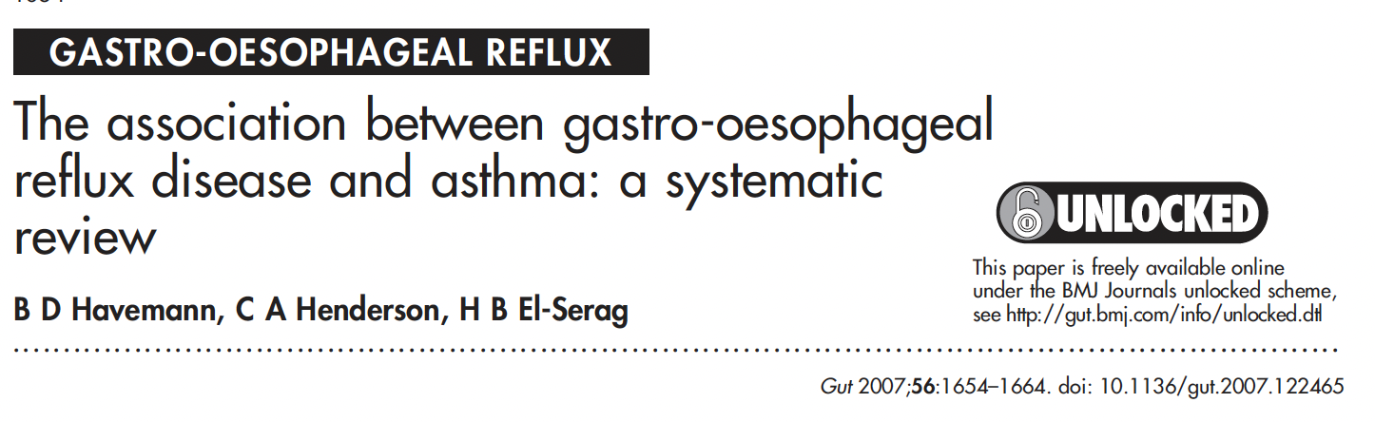
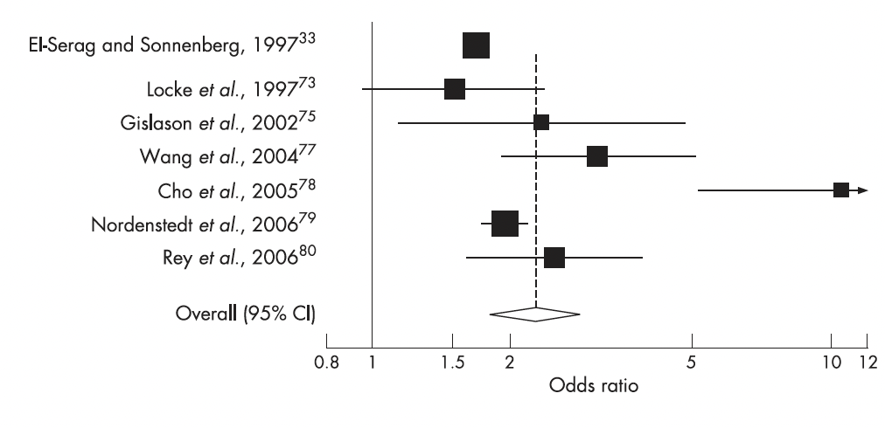
Asthma and reflux are associated.
Notes:
[ ] todo: Replace this with chat GPT question: explain the relationship between reflux and asthma from the prospective of a researcher looking for grant funding
Also, add trinetx age by ppi in asthma graph

Slide 9
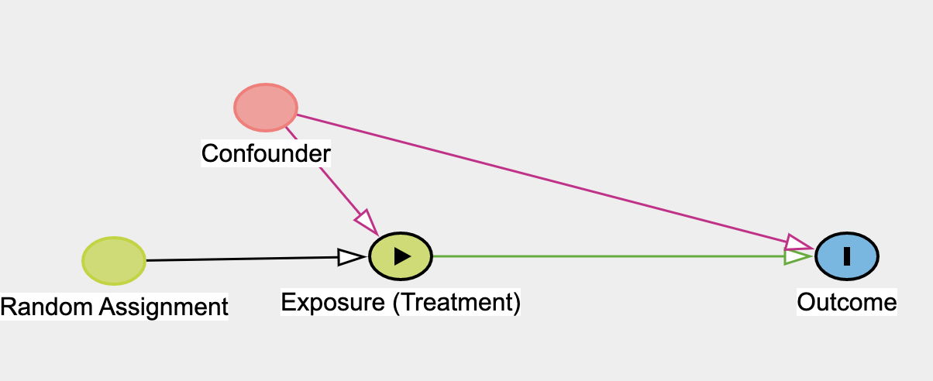
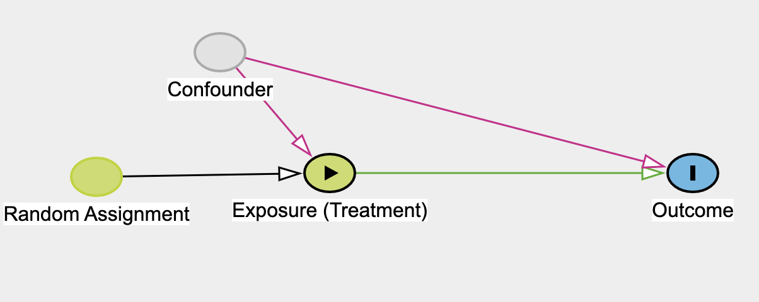
Traditional conception of an RCT:
Test of a hypothesis: Is there evidence to reject the null?
Fisher: not to estimate the size of the effect – only is there evidence for !=Null
Randomize, analyze all by ITT principle, complete adh. & ascertainment

Slide 10
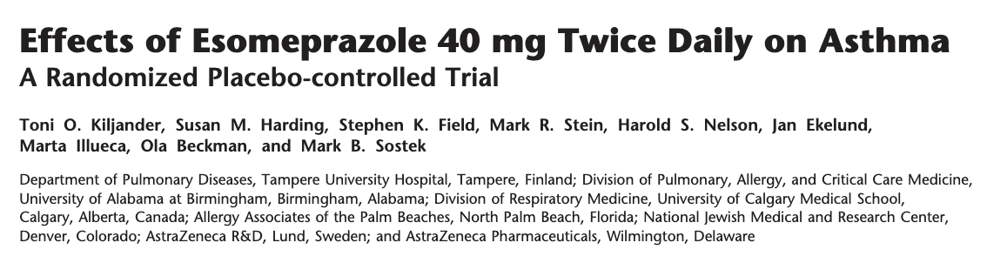
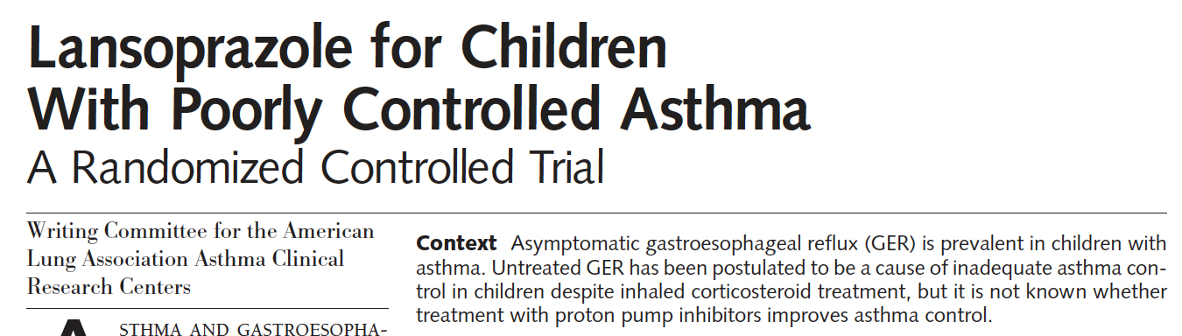
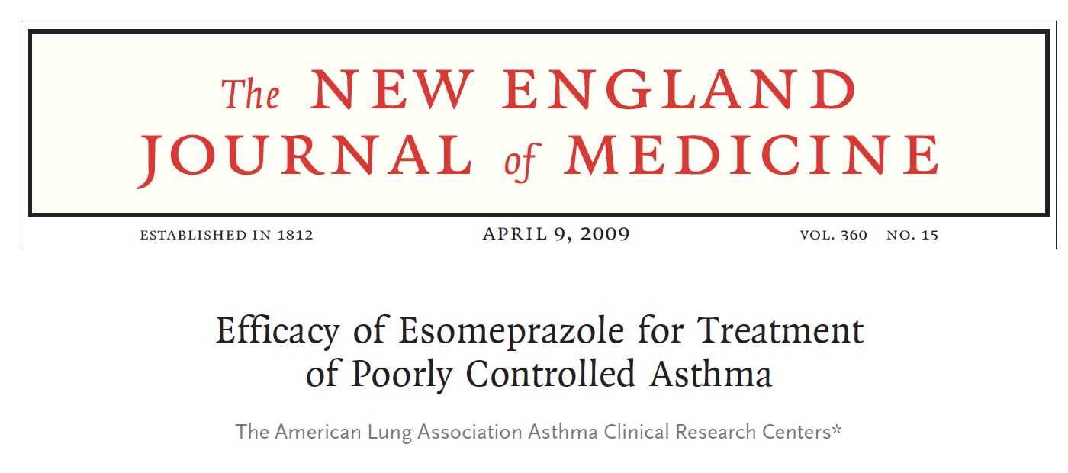
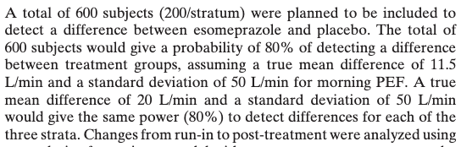
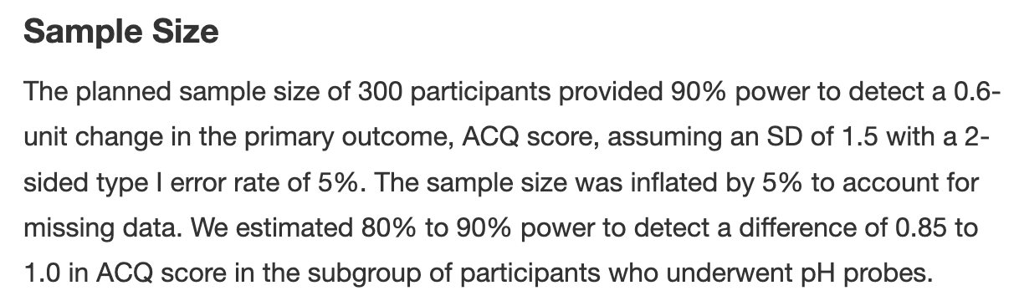
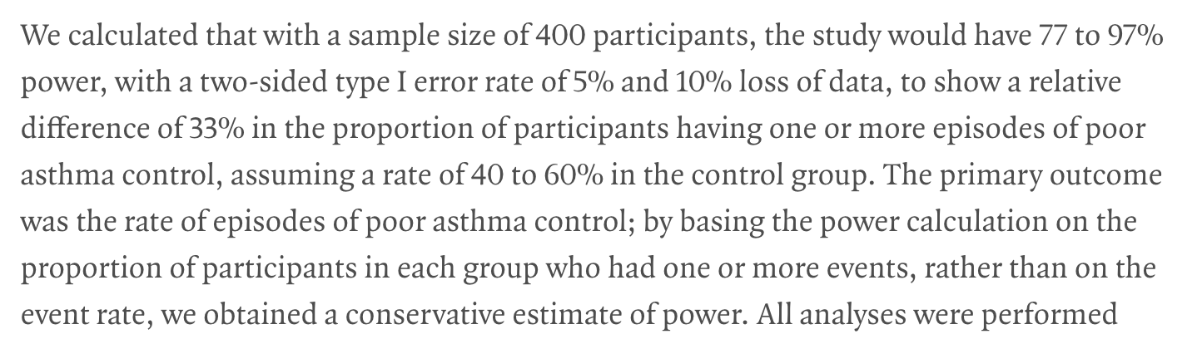
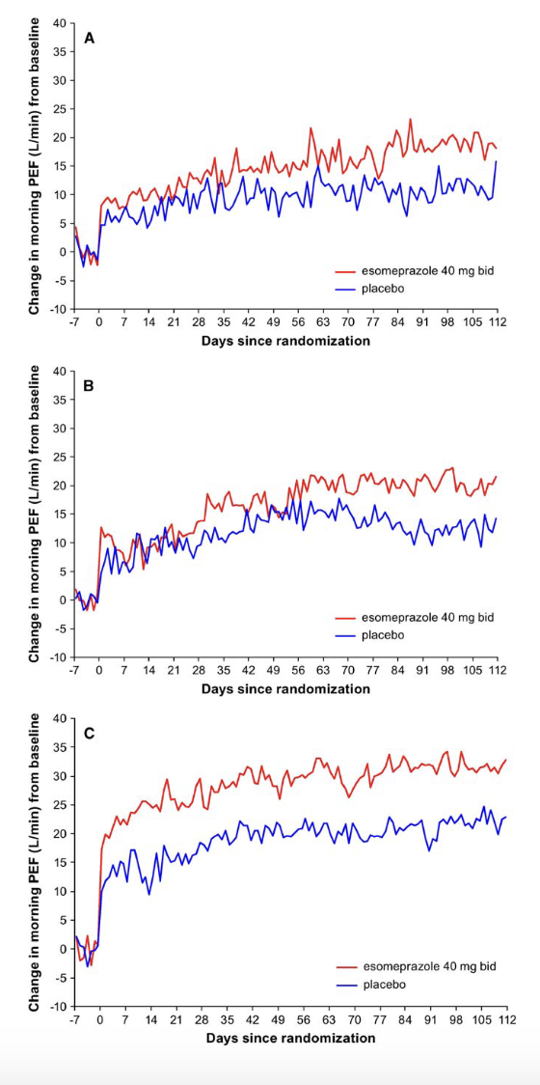
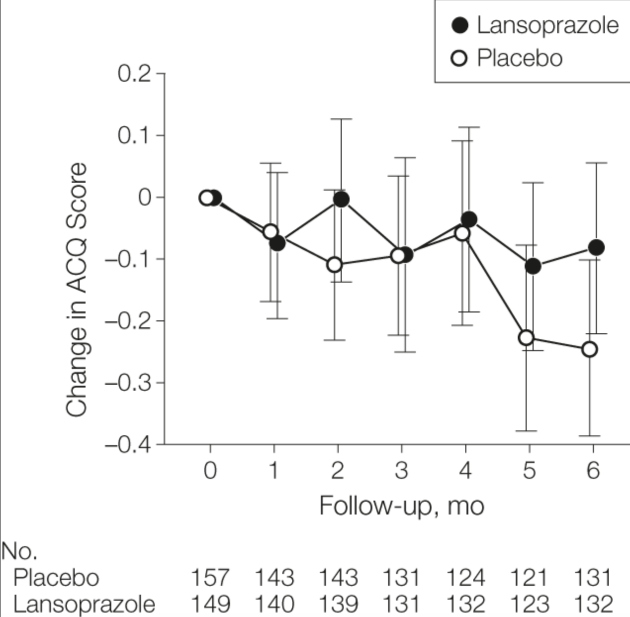
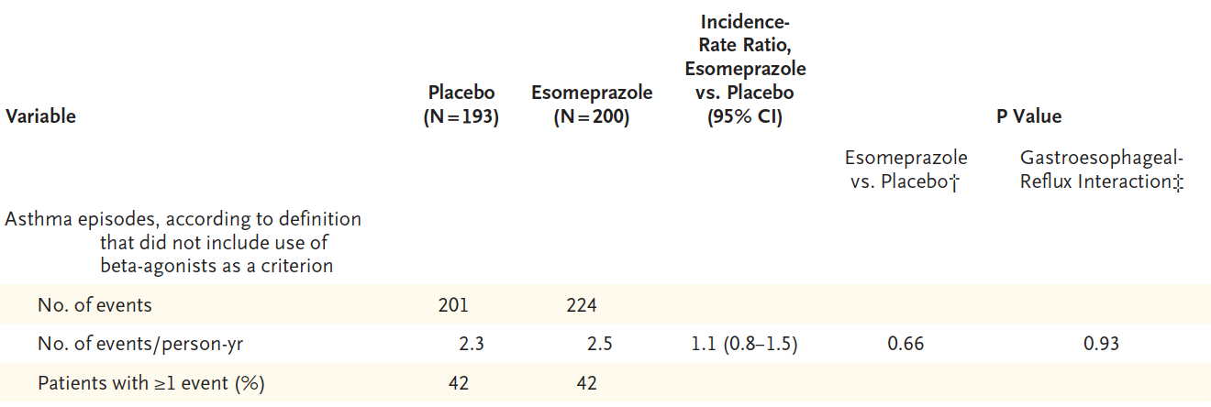
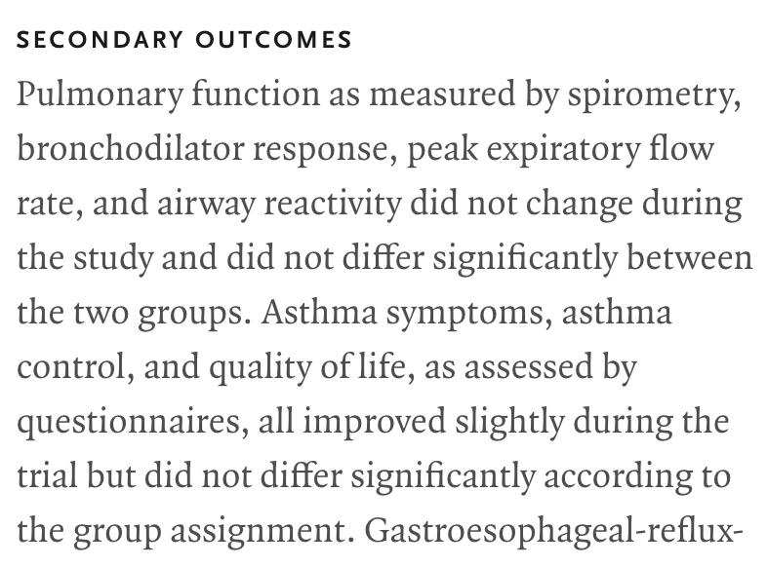
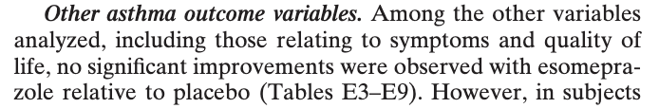
Notes:
Any 3 studies with effect sizes approximating the delta they are powered for: 0.8^3 = 50%

Slide 11
In defense of Meta-analyses:
Next time? Any takers
I’d argue that for most problems in pulmonary critical care, the best source of evidence is the best meta-analysis, not the best individual trial.
The way trials are currently funded leads to them being systematically underpowered and not fit to answer the relevant question.
GIGO is a problem, but it’s less of one than you might think
Notes:
Reference under powering our cities as a threat to using them as the only acceptable sort of knowledge. Or more precisely saying our cities have not shown in affect therefore, there is none. Because I see Peter systematically under powered to find important effects I’ll give a defensive met and I’ll see you in the talk next time
Hi! Because the way trials are funded, we systematically create under powered trials. Additionally, Madison is in the business of small effect as findings.
Under powering up studies the biggest problem it’s a threat to RSVP for the top of the evidence.. The debate claim would be there for most problems and Critical Care, and pulmonary medicine. The best source of evidence is the farthest metanalysis rather than the biggest trail.
And the way that trials are powered with the smallest trial that can accomplish given power – how many trials would you expect to cagree in their summary measure?

Slide 12
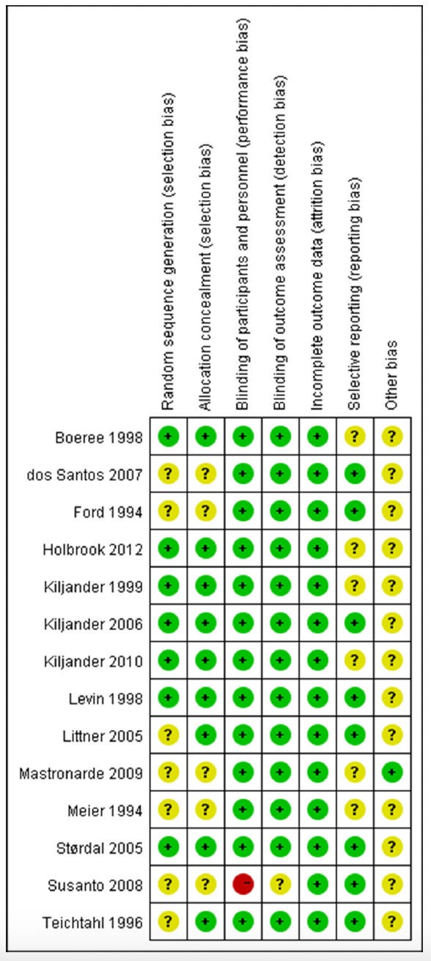

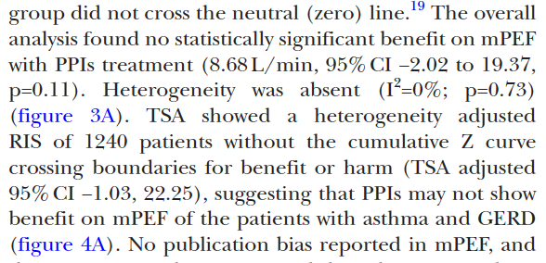
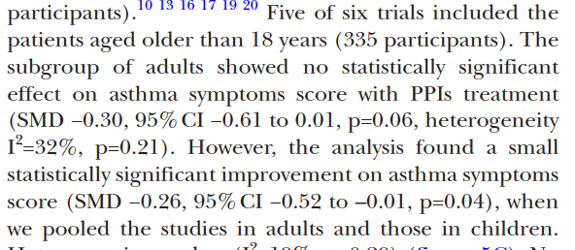
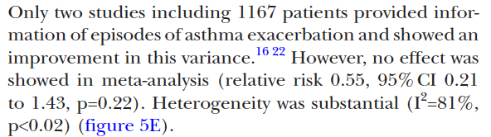
Notes:
Not definitive. 2,200 patients.

Slide 13

GINA 2022
“In patients with confirmed asthma, GERD should be considered as a cause of a dry cough; however there is no value in screening patients with uncontrolled asthma for GERD (Evidence A)”
Benefits of PPI appear to be limited to patients with both symptomatic reflux and nocturnal respiratory symptoms.

Slide 14
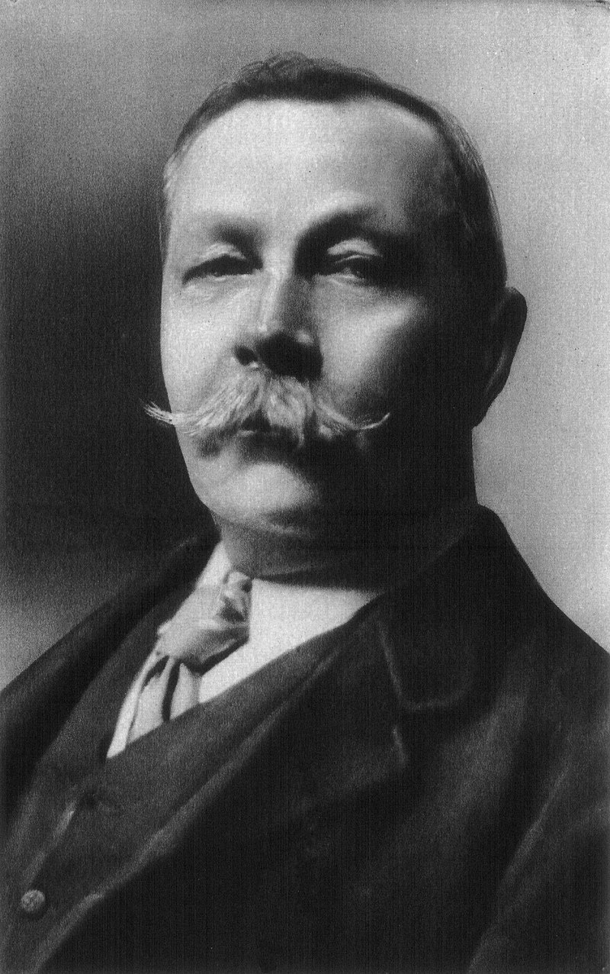
Argument of a(n observational) study
There are for possible reasons for an association:
Causation
Observation bias or information bias:
Systematic error distorting the exposure-outcome relationship
Confounding
Chance
Disjunctive syllogism: “When you have eliminated all which is impossible, then whatever remains, however improbable, must be the truth.” Arthur Conan Doyle
Find everything that causes a change in P(Exposure) and P(Outcome)
aka a confounder
Use one of several methods to control (‘adjust’) for those variables
Matching, Restriction, stratification, multivariable regression, etc

Slide 15
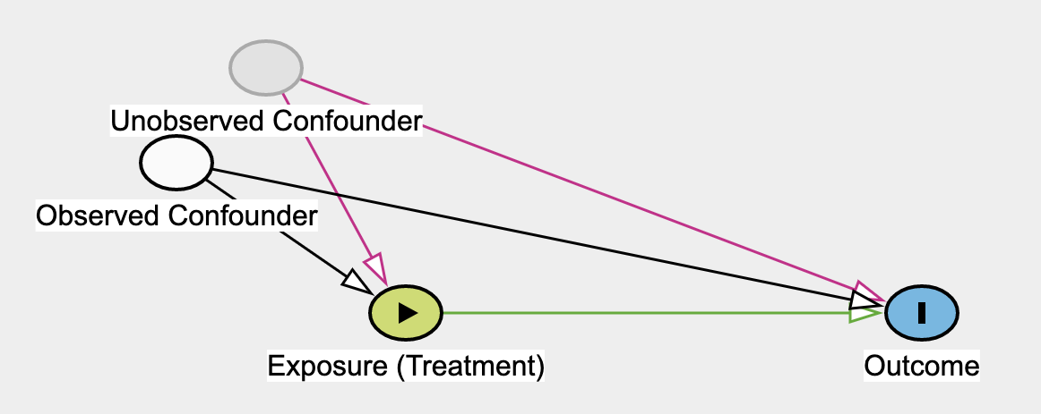
Assumptions of ‘controlling for confounders’
For regression modeling to accurately estimate causal effect:
No unmeasured (unaccounted for) confounders.
Confounder-Exposure and Confounder-Outcome relationships properly modeled.
These assumptions cannot be directly verified.
Research will be dubious if:
If the strength of confounders is strong in comparison to the main effect
Or if the confounders are hard to accurately measure
Their relationships are confusing (e.g. nonlinear)
Attempts to address: sensitivity analyses, negative ‘control’ outcomes
Problem
Problem?
Problem?
Notes:
On as concerned with confounding – doesn’t address sources of bias.
For a traditional observational design, it is very hard to test the assumption that there are no unmeasured confounders, and the confounders their relation to the outcome was assessed/modeled correctly:
Sensitivity analyses
Negative ‘control’ outcomes

Slide 16
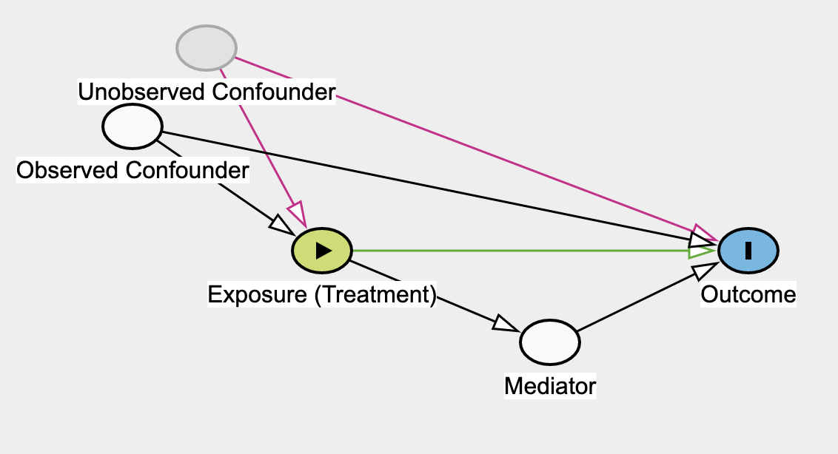
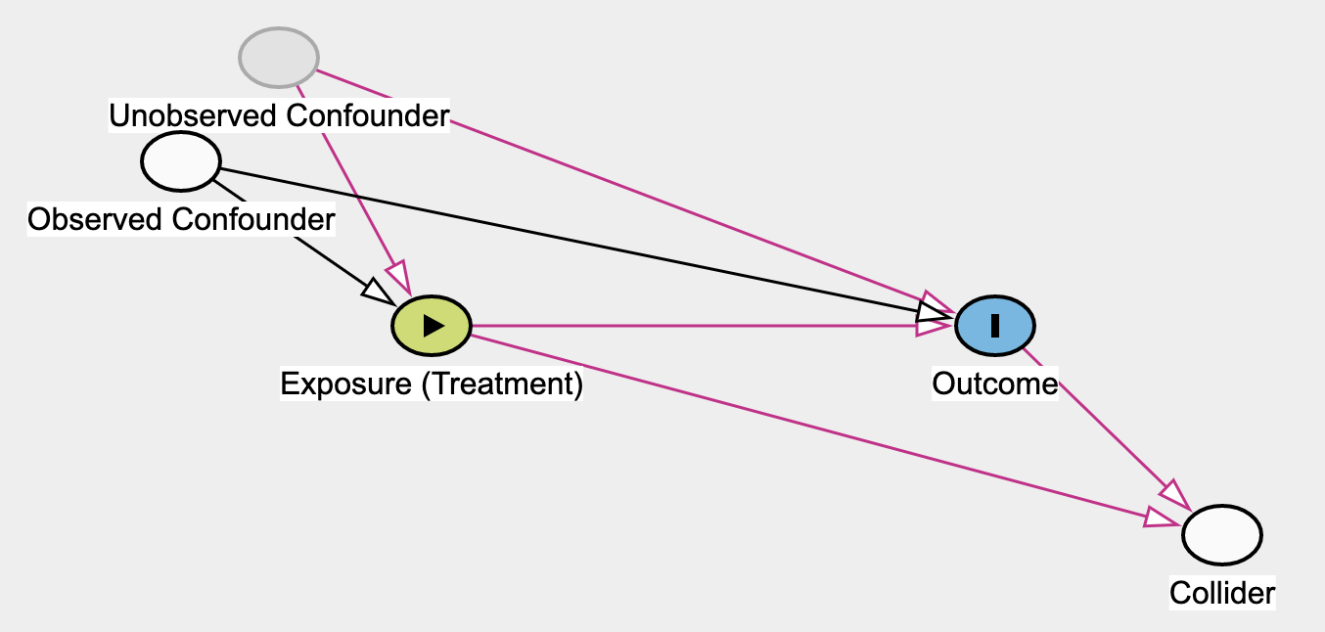
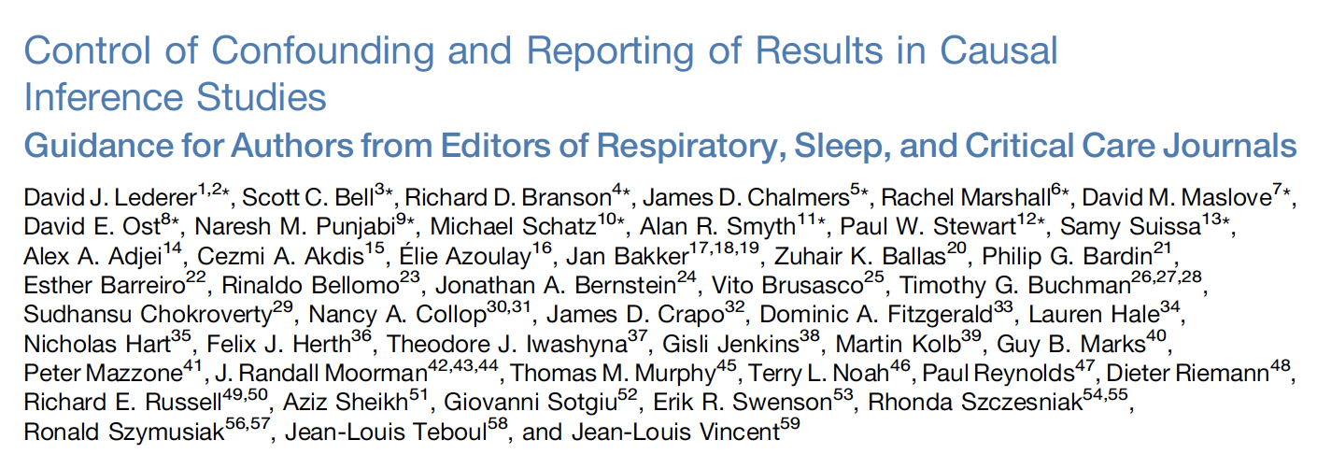
Examples:
Collider: The exposure and the outcome both effect a third variable (the collider; name: 2 arrows on the DAG collide). Introduces bias if collider controlled
Intuition: Say an C can only happen by either A or B but not the combination A+B (or that’s rare). The controlling C -> negative association between A and B
C: Harvard admission; A: Smarts; B: Athletics. -> Matriculants either smart or athletic (inversely related)
Take-away: putting all the possible confounders in a regression model and hoping for the best = not going to work.
Notes:
OSA Severity or Pneumonia Severity → ICU Admission for Respiratory Failure: Apparent protective effect of OSA in cohorts of ICU patients.
Adjusting for elevation, Mount Everest has the same air pressure as New York City
Table 2 fallacy

Slide 17
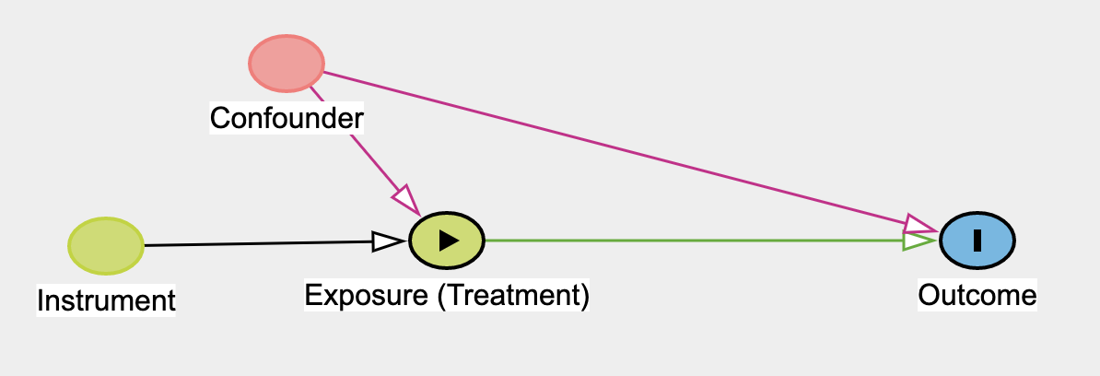
What is an instrument
What is an instrument? Something that “vibrates” the likelihood of exposure but have no other reason it’d be related to the outcome.
The instrument is only related to the outcome via the exposure.
No common cause of the instrument and the outcome.
IF you are interested in the size of the effect (not just yes/no), an additional assumption: distribution of effect modifiers is the same among exposed and unexposed.
Stronger relationship to exposure = More powerful instrument
Notes:
Association with the exposure and the outcome is unconfounded (*conditional on the measured variates – meaning this can be controlled)

Slide 18

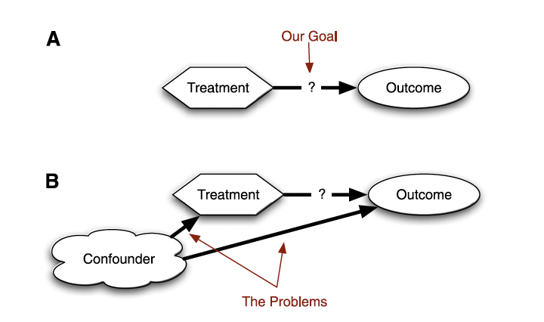
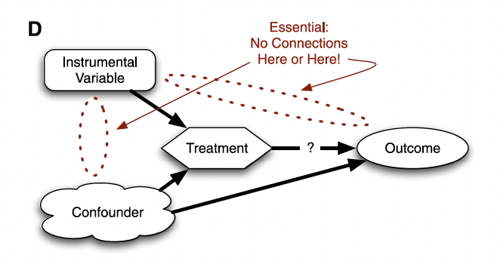
Why is this useful?
Assumptions:
Traditional Study: Exposure is unconfounded
Instrumental Variable Study: Instrument is unconfounded.
What did we gain? The actual relationships may be very different
“Evidence triangulation”: If the effect estimate is similar under different assumptions -> evidence in favor of the causal effect
vs repeating studies continent on the same assumptions

Slide 19
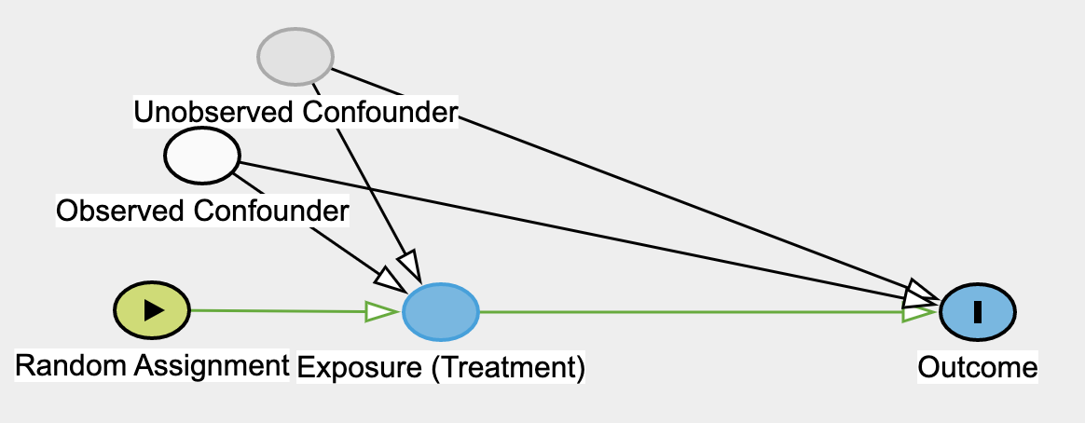
Examples of instruments
Randomization (ultimate instrument)
Only can be associated with the outcome via the exposure (no other way the coin flip could influence the outcome)
Cannot have a common cause with the outcome (by definition, it’s random)
Intention to treat*: effect of randomization on the outcome
The marginal effect of the policy on the group; *needs fewest assumptions
IV effect estimate: estimated effect of the treatment for people who were treated because of their random assignment.
People who would not have been treated in the control but are treated in the active arm. “Compliers”, “Marginal Patients”
Assumption: effect modifiers do not differ between compliers and non-compliers
Notes:
Per protocol sucks and should generally be ignored.
These estimates diverge as adherence is lower
Can’t say anything about people who would not have taken the treatment either way or people who would have taken the treatment either way.

Slide 20
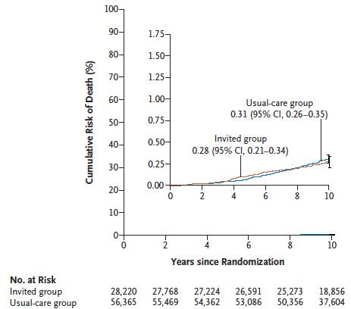

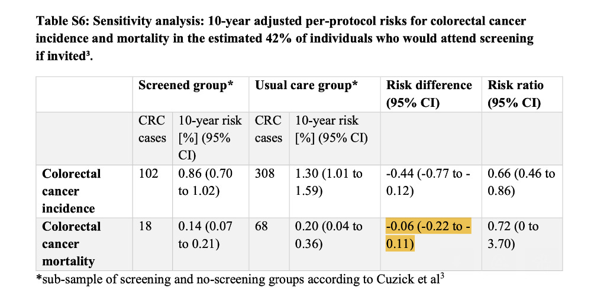
3 European countries without colon cancer screening; randomized 84585 patients 55-64 y/o to a single invitation to colon cancer screening.
42% underwent screening (compared, ~60% in USA)
ITT: RR Colon Cancer Mortality 0.90 (CI 0.64-1.16)
(10y outcomes reported; powered for 15y outcomes)
Notes:
[ ] should harden up the “how you do the IV analysis step”

Slide 21
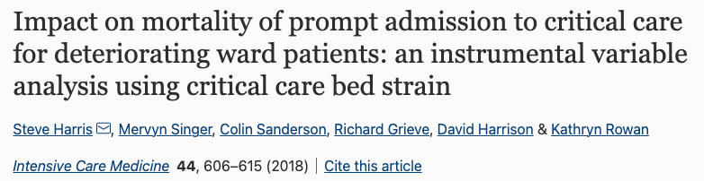
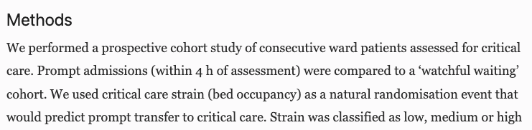
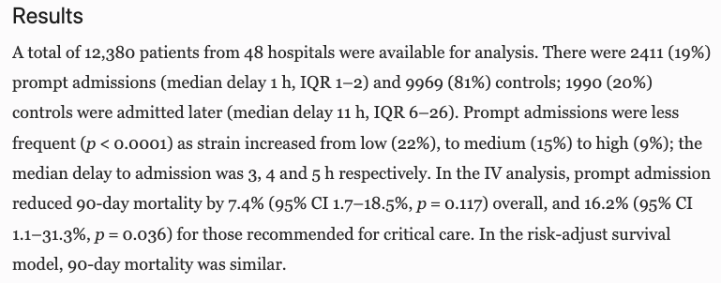
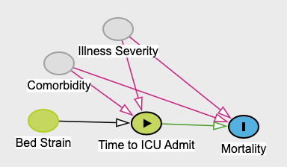
Example:
Instrument: Bed Strain
Exposure: time to ICU admit
Bed Strain does influence admit speed
Assumptions:
There are no common cause of bed strain and admit speed
Bed strain only influence mortality through time to ICU admit

Slide 22
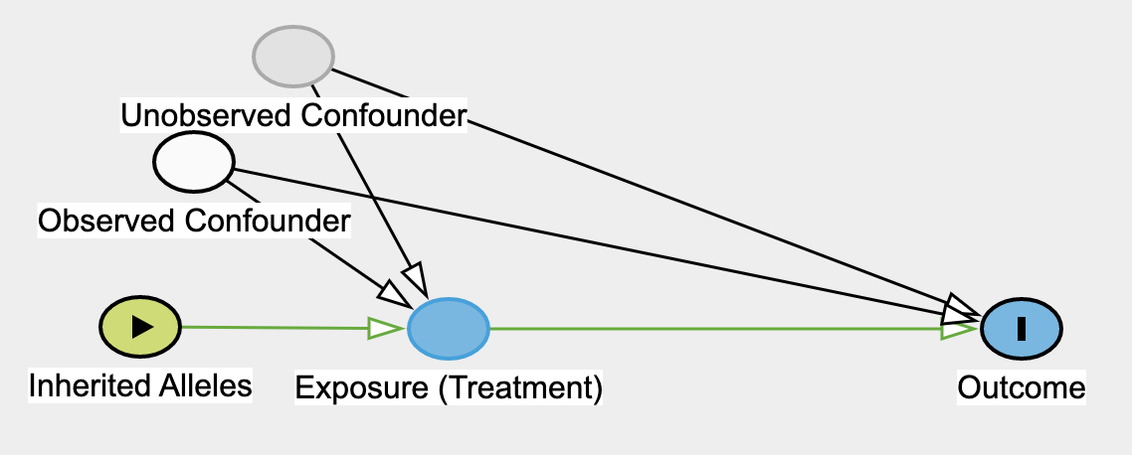
Example: Genetic Assortment
Genes assort randomly-ish*, from either parent
If those genes are associated with an exposure (e.g. LDL level, coffee intake, alcohol intake, predisposition to exercise), they may fit the definition of an instrument for some outcomes:
Relavence: Predictor of exposure (can be assessed numerically)
No common cause of the instrument and the outcome.
To the extent genetic assortment is random – it’s impossible. No reverse causation
Independence: *Allele frequencies can differ by, say, race (confounders). Or, be in linkage disequilibrium with other alleles that influence outcome risk.
All of the association with the outcome is mediated by the exposure.
Exclusion Restriction: No Horizontal Pleiotropy (influence multiple pathways)
Notes:
Mom has a higher predisposition to LDL levels, dad has a lower risk – you’re randomized to one of the two.
It turns out, empirically, that most allele frequency spread out decently through the population – so this works ok
Mendel’s laws of
inheritance (randomsegregation and
independent assortment of genes),
Pleiotropic effects—the effects of a genetic variant on multiple biological pathways. These can either affect the outcome through another trait or pathway to the one under investigation, known as horizontal pleiotropy, or affect other traits through the risk factor of interest, known as vertical pleiotropy.1 Horizontal pleiotropy is a violation of the instrumental variable assumptions because the effects of the genetic variant on the outcome are not exclusively through the risk factor; this is problematic for Mendelian randomisation studies. Vertical pleiotropy is in fact the essence of Mendelian randomisation—showing that one factor influences a downstream outcome—and is in general not problematic1

Slide 23

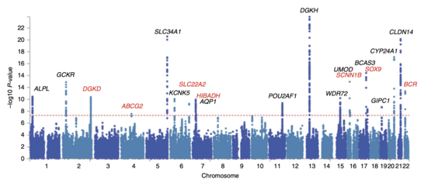

Why Now? Bio GWAS
Genome-Wide Association Studies (GWAS)
Genetic sequencing (SNPs)
Clinical information
500,000 individuals (each)
Notes:
three large genome-wide association studies (GWAS) of European ancestry

Slide 24

Mendelian Randomization
Regression using genetic loci (SNPs) to predict ‘exposure’ risk.
Instrument = “genetic predisposition to the exposure”.
This step verifies how “strong” the instrument is
weak = low power; violation in IV assumptions have bigger effect.
Evaluate the instrument [predicted genetic risk of exposure] to correlation with the outcome
The two steps can be done in different datasets (‘two sample MR’)
GWAS studies: effect of each polymorphism on an outcome (UK Biobank, Finn)
Effect of each polymorphism on the ‘treatment’/exposure
Notes:
Single sample Mendelian randomisation—using one dataset in the instrumental variable analysis to yield the causal estimate of the risk factor on the outcome
Two sample Mendelian randomisation—using two different study samples to estimate the instrument-risk factor and instrument-outcome associations to estimate a causal effect of the risk factor on the outcome. This can be useful when the risk factor or outcome, or both, are expensive to measure.1718 It also provides an opportunity to substantially increase the statistical power, by incorporating data from multiple sources, including large consortia17
MR Egger regression—a statistical technique that allows one or more genetic variants to have pleiotropic effects, as long as the size of these pleiotropic effects is independent of the size of the genetic variants’ effects on the risk factor of interest19

Slide 25
Coffee Intake
Conventional Analysis Assumptions:
People who drink coffee are similar in risk of mortality to people who don’t, except for the coffee
Dubious: Rich people with white color jobs drink coffee.
Mendelian Randomization Assumptions:
Genetic predisposition (e.g. caffeine metabolism variants) not in linkage disequilibrium with other alleles predicting mortality; the variants that influence coffee consumption don’t influence mortality through another pathway
Maybe? But VERY different than the type of assumptions for the observational cohort.

Slide 26
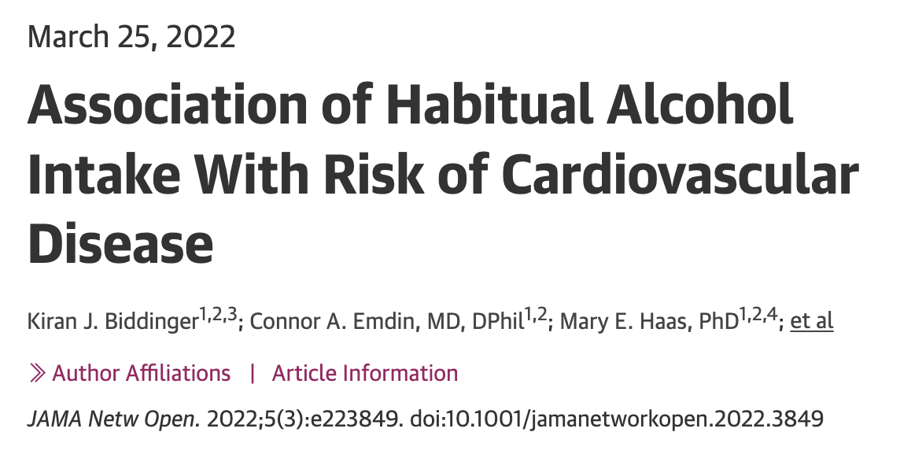
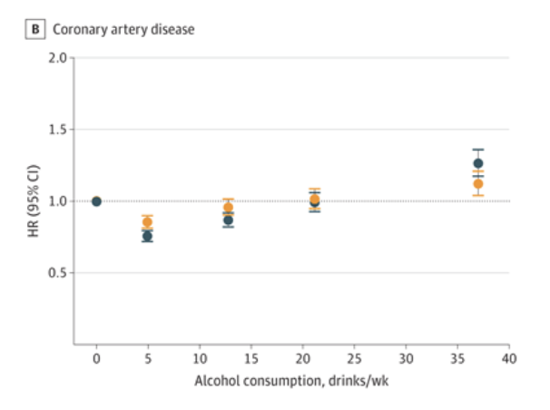
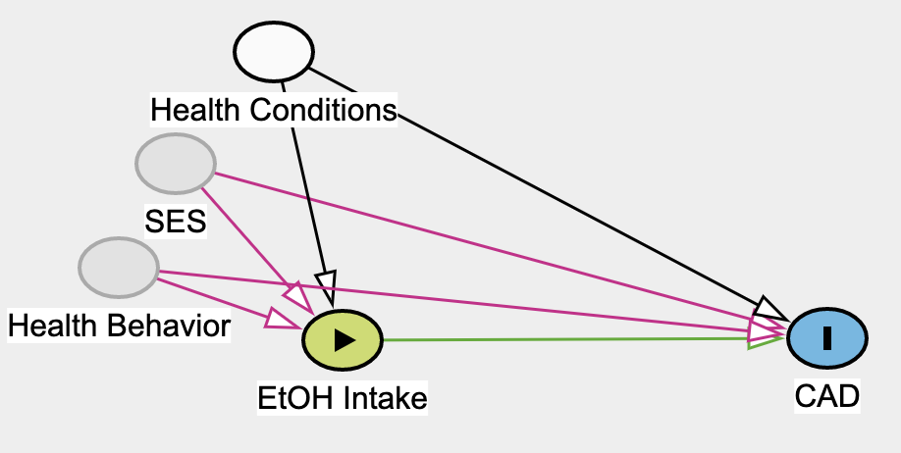
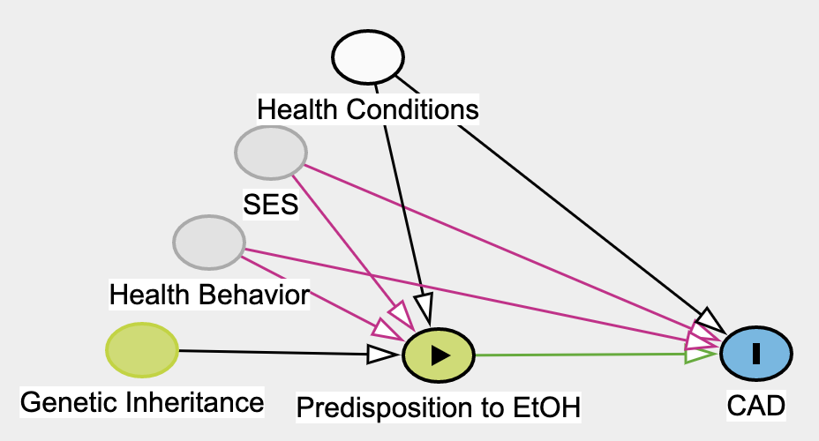
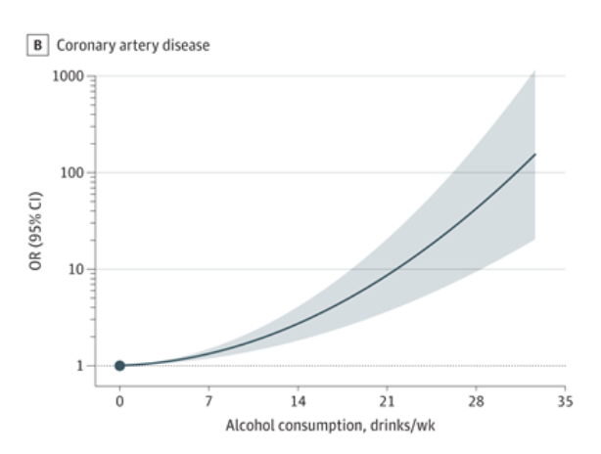
Alcohol
Conventional Analysis
Assumptions: People who drink alcohol are like people who don’t (except for in the ways we can measure and control for) in terms of CAD risk.
Mendelian Randomization
Assumptions: Alleles that influence predisposition to alcohol intake (think: alcohol dehydrogenase variants) are random and don’t influence CAD through other mechanisms
Notes:
https://pubmed.ncbi.nlm.nih.gov/35333364/

Slide 27
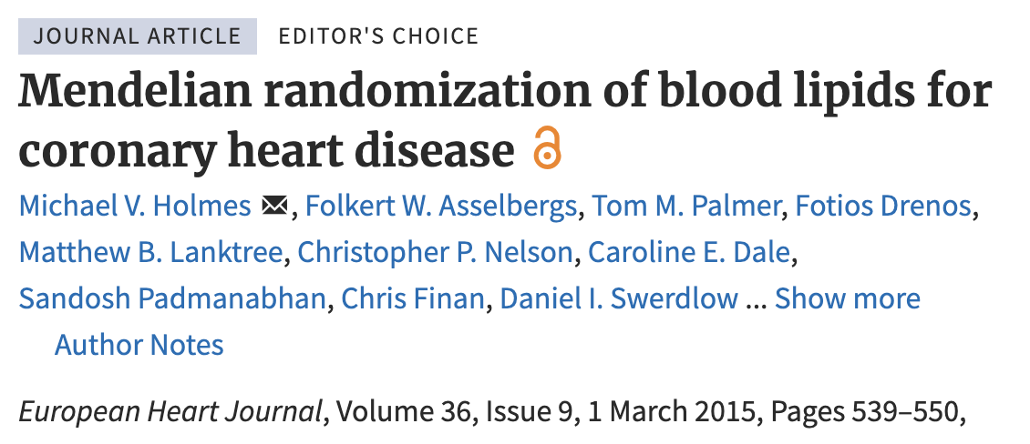

(+)control: LDL Cholesterol -> CAD
Countless RCTs prove interventions that lower LDL lower CAD risk
RCTs of raising HDL failed, despite promising observational data
Notes:
Maybe this one? https://pubmed.ncbi.nlm.nih.gov/19903920/ or https://pubmed.ncbi.nlm.nih.gov/24097064/

Slide 28
Exercise
Conventional Analysis
Assumptions:
Reverse causation
Mendelian Randomization
Assumptions:

Slide 29

GERD, on asthma? AJRCCM 2023
Notes:
Also investigated atopic dermatitis’ relationship to these entities: The atopic march theory, however, supposes that some AD serves as a precursor to asthma

Slide 30


Observational study: JACI 2019
National sample (Korea), 2002-2013; Cox-proportional hazards model (=control for the covariates: age, urban/rural, income, CCI, depression, COPD, OSA, BMI)
Incident asthma is more common (HR 1.46; 95CI 1.42-1.49) in patients with GERD compared to those without GERD
Incident GERD is more common (HR 1.36; 95XCI 1.33-1.39) in patients with asthma compared to those without asthma
Incident disease: reverse causation
Confounders? (healthcare exposure, etc.)
Notes:
https://www.sciencedirect.com/science/article/abs/pii/S2213219819309377

Slide 31

Mendelian Randomization:
Step 1: Generate associations between genetic variants (SNPs) with GERD
Genome-wide association study with 71,522 cases and 261,079 controls
Evaluate for linkage disequilibrium among candidates using HapMap 3 (Independence Assumption)
Evaluate the strength of association and remove SNPs that would be weak instruments, meaning they don’t change p(GERD) much
Use regression to “genetic predisposition to GERD” value (=the IV)
21 GERD-associated SNPs in the GWAS summary statistics that were sufficiently strong. (Relevance assumption)
Importantly, these genes are NOT associated with asthma risk in the entire population.
Should be >10
Notes:
Ahn and colleagues used several techniques to minimize pleiotropy and evaluate the robustness of their effect estimates. To identify independent instrument variables for MR, stringent linkage disequilibrium thresholds were used to ensure the independence of single-nucleotide polymorphisms from each GWAS meta-analysis and F-statistics to assess the strength of the instrument variables that were used. Three statistical approaches to MR, random effect inverse variance-weighted method, MR-Egger regression, and MR-pleiotropy residual sum and outlier, were used to determine the causal effects, assess for robustness, and minimize the influence of pleiotropy on their results. Combined, these approaches strengthen the causal relationships reported in their study.
UNABLE TO ACCOUNT FOR EFFECT MODIFICATION (presence/absence of obesity, OSA, allergic rhinitis in particular)

Slide 32


Mendelian Randomization: Results
Step 2: Perform the IV analysis
3 different methods for exactly how you combine the instrumental variables and evaluate for pleiotropy (Exclusion Restriction)
If you have GERD from genetic predisposition, your risk of asthma is increased by 21% (OR, 1.21; 95% CI, 1.09–1.35).”
Notes:
MR-Egger

Slide 33
Results: no reverse causation
Genetic Predisposition to GERD -> Asthma | odds ratio [OR], 1.21; 95% confidence interval [CI], 1.09–1.35
Genetic Predisposition to Asthma -> GERD | OR, 1.06; 95% CI, 1.03–1.09
Genetic Predisposition to Atopic Dermatitis (AD) -> GERD | OR 1.01 95 CI 0.97-1.06
Genetic Predisposition to GERD -> AD | GERD also increased risk of AD (OR, 1.21; 95% CI, 1.07–1.37;
Genetic Predisposition to Asthma -> AD | OR, 1.46; 95% CI, 1.34–1.59;
Genetic Predisposition to AD -> Asthma | odds ratio [OR], 1.34; 95% confidence interval [CI], 1.24–1.45;

Slide 34
Study Conclusions
Supports causal link between GERD and Asthma:
Both arise from the foregut: are people proposed to GERD proposed to asthma or does GERD (reflux->acidification) cause Asthma?
Also supports bi-directional causation between Atopic Dermatitis and Asthma
Atopic march (AD->asthma) and…. ??? (Asthma->AD)
Or, is this evidence of the assumptions not holding?
For magnitude: absence of effect modification can’t be verified
All the same concerns about information bias, generalization = same.
Biobanks: Northern Europeans.

Slide 35
Returning to the case…
Not 100% sure what caused his asthma
Moderately well controlled on high dose ICS/LABA – still some limitations to things like skiing but no exacerbations in last year.
Not occupational asthma (still bad during seasons he isn’t spraying). RADS possible(?).
On PPI, still has symptoms … but would they be worse without?
Decided not to eliminate the cat.

Slide 36

Links
Paper: AJRCCM Mendelian Randomization Analysis Reveals a Complex Genetic Interplay among Atopic Dermatitis, Asthma, and Gastroesophageal Reflux Disease https://www.atsjournals.org/doi/epdf/10.1164/rccm.202205-0951OC?role=tab
BMJ 2018: Reading Mendelian randomization studies: a guide, glossary, and checklist for clinicians https://www.bmj.com/content/362/bmj.k601
JAMA 2019: Guide to Statistics in Medicine: Instrumental Variables to Address Bias https://jamanetwork.com/journals/jama/fullarticle/2732940
AJRCCM 2018 Control of Confounding and Reporting of Results in Causal Inference Studies. Guidance for Authors from Editors of Respiratory, Sleep, and Critical Care Journals https://www.atsjournals.org/doi/10.1513/AnnalsATS.201808-564PS

